Slide 1
Mining Mahjong Board States for Heuristics
(Specifically relating to the chiitoi)

Slide 2
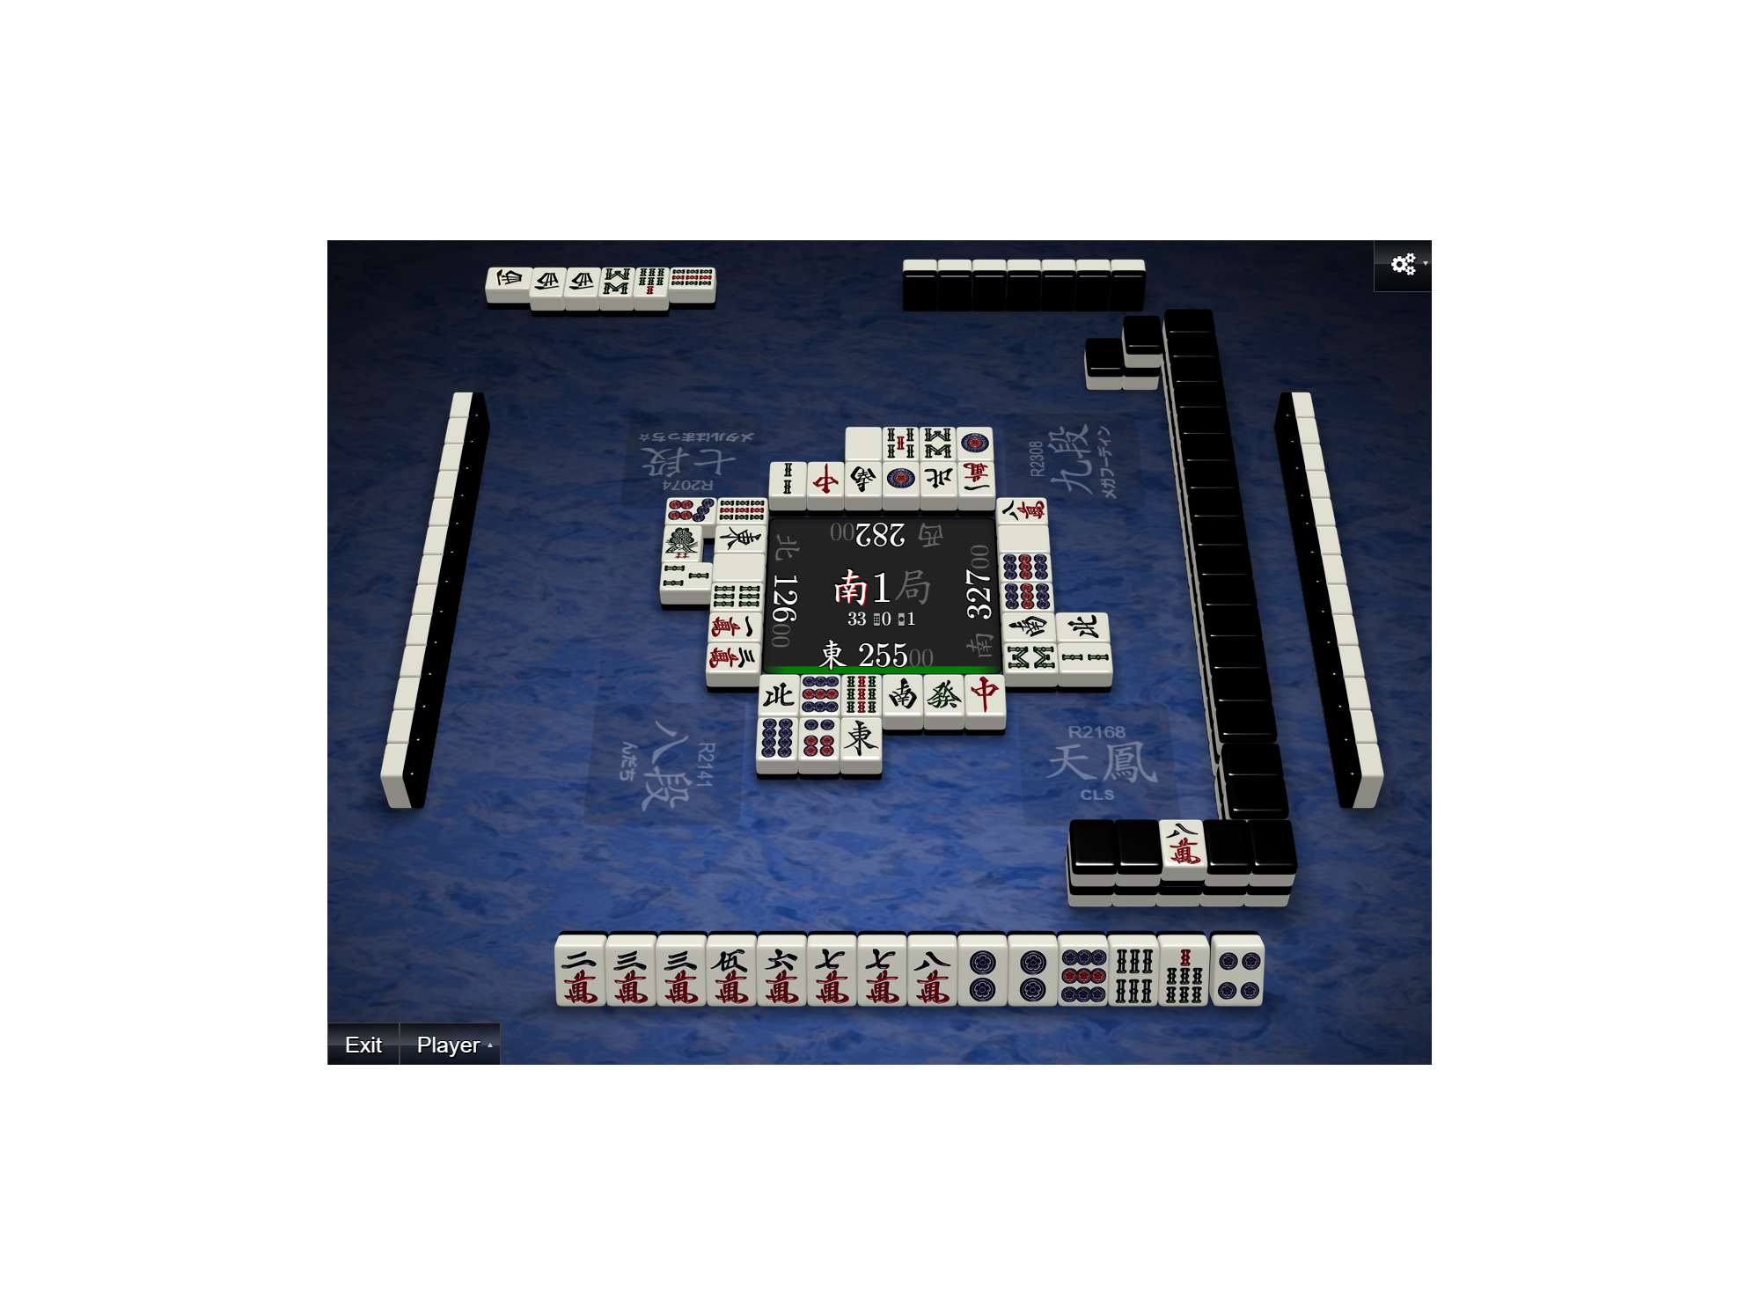
Notes:
Mahjong overview

Slide 3
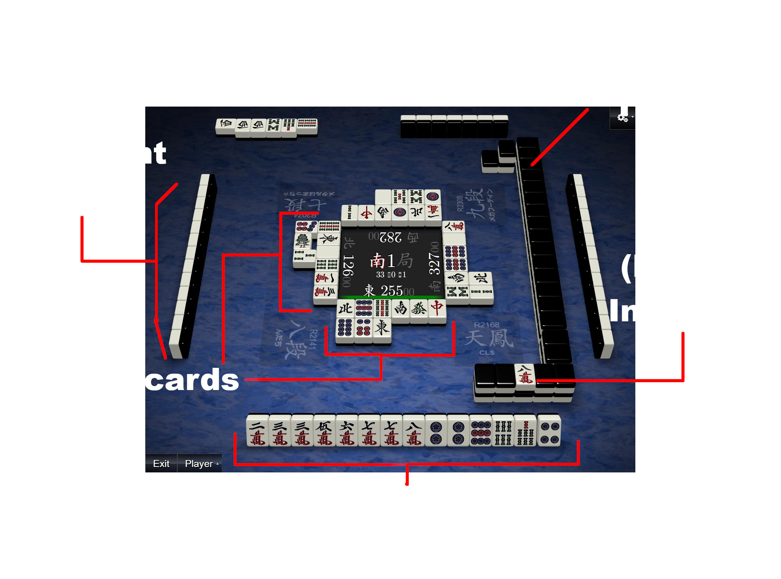
Notes:
Mahjong overview

Slide 4
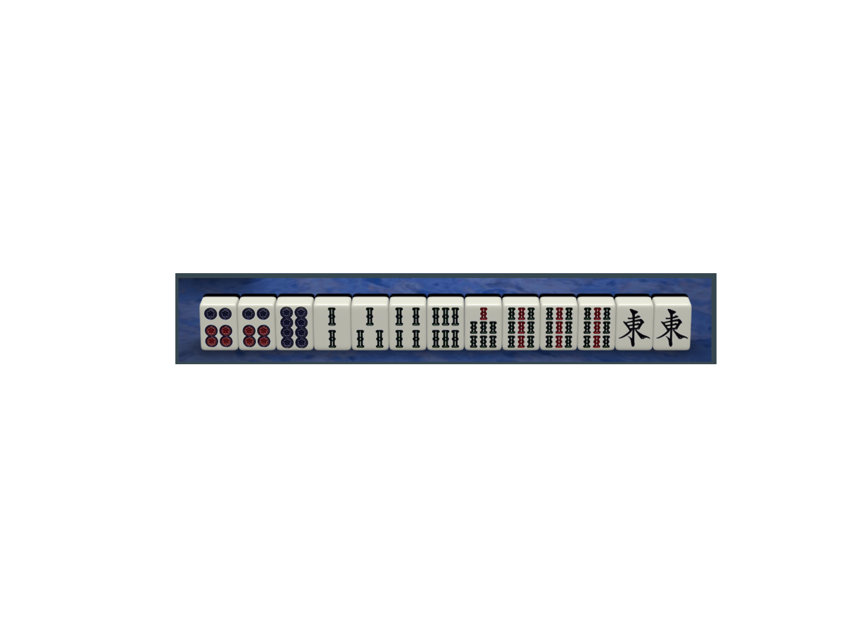
Notes:
Basic Hand Overview

Slide 5
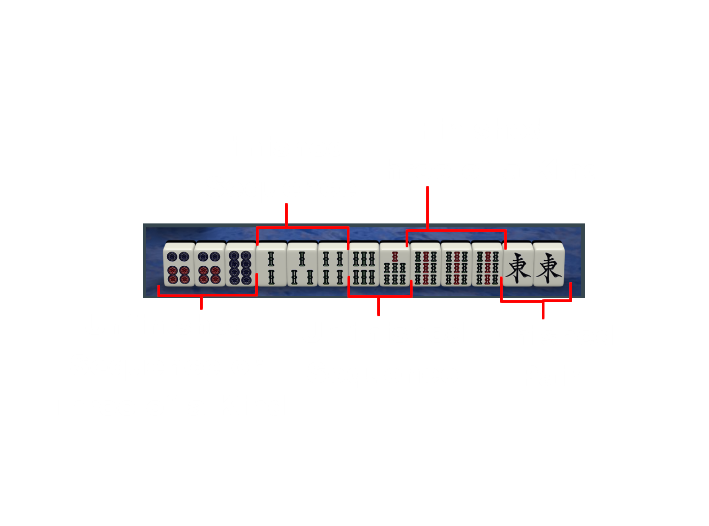
Notes:
Basic Hand Overview

Slide 6
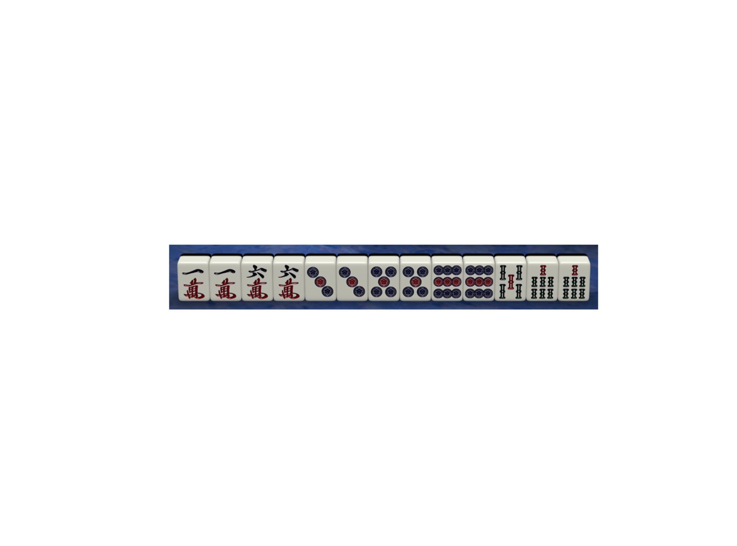
Notes:
The Chiitoi

Slide 7
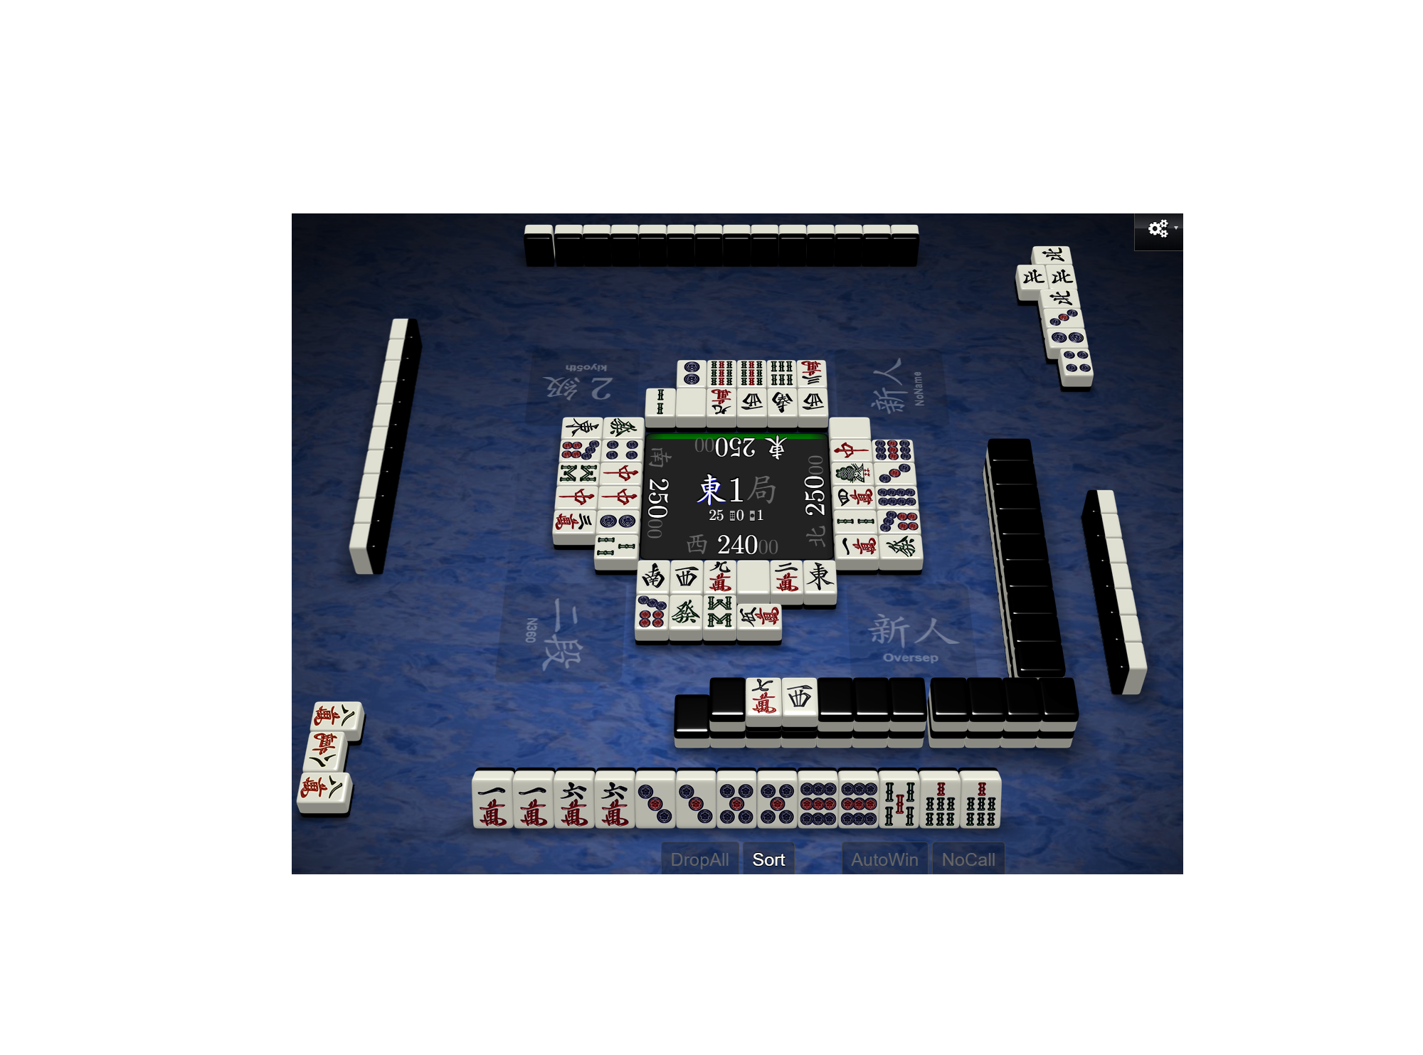
Notes:
Full game - half suji trap

Slide 8
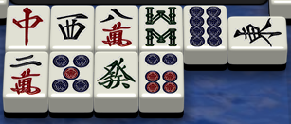
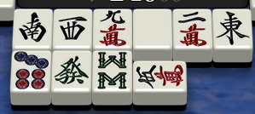
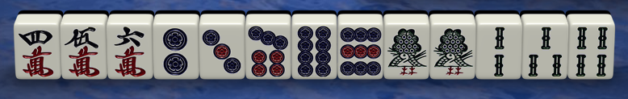
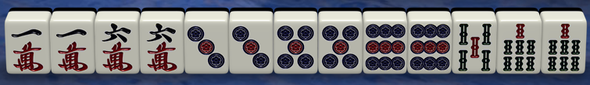
?

Slide 9
Discard Dataset
Clean
Train/Validate
Test
Train Transformer Model (Low Layer Ideal)
Test Model
Locate Heuristics
Examine Gradients
Notes:
High concept methodology

Slide 10
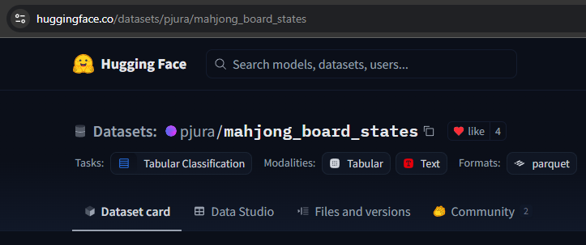
Notes:
The dataset

Slide 11
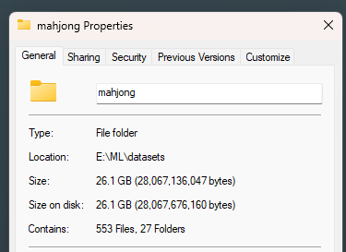
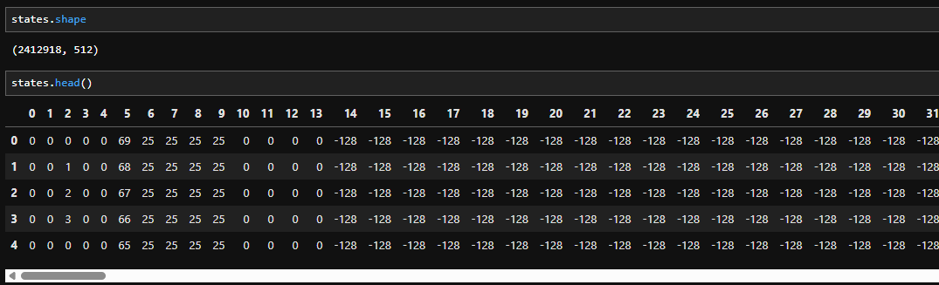
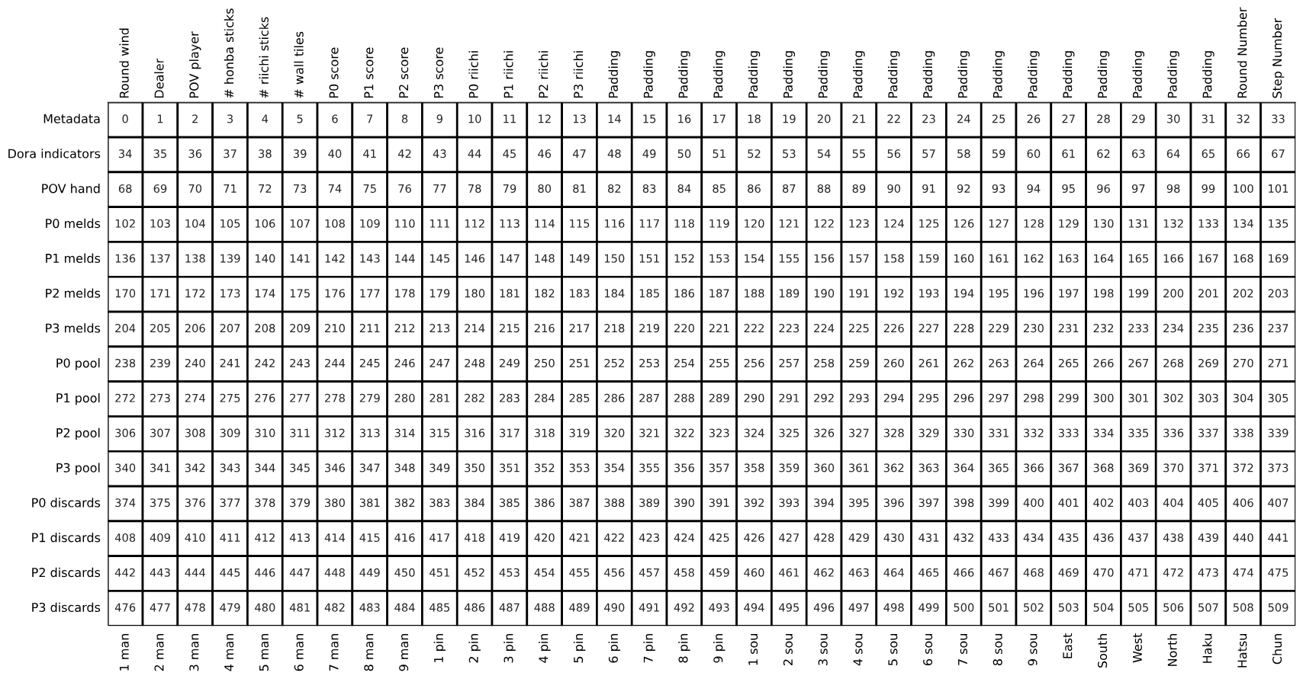
Notes:
Only working with 100MB of data

Slide 12
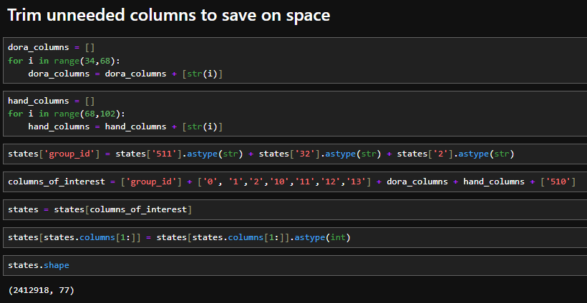

Slide 13
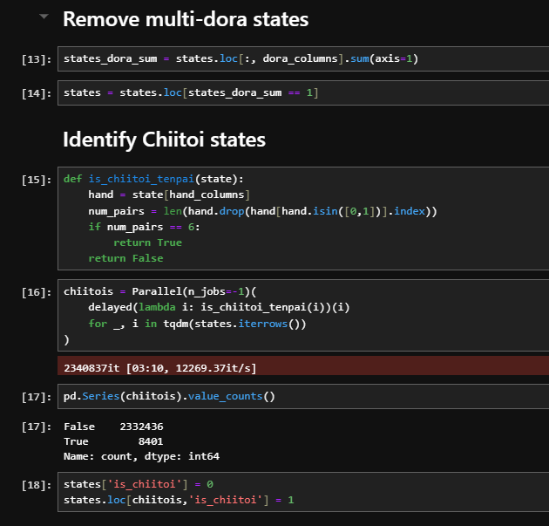

Slide 14

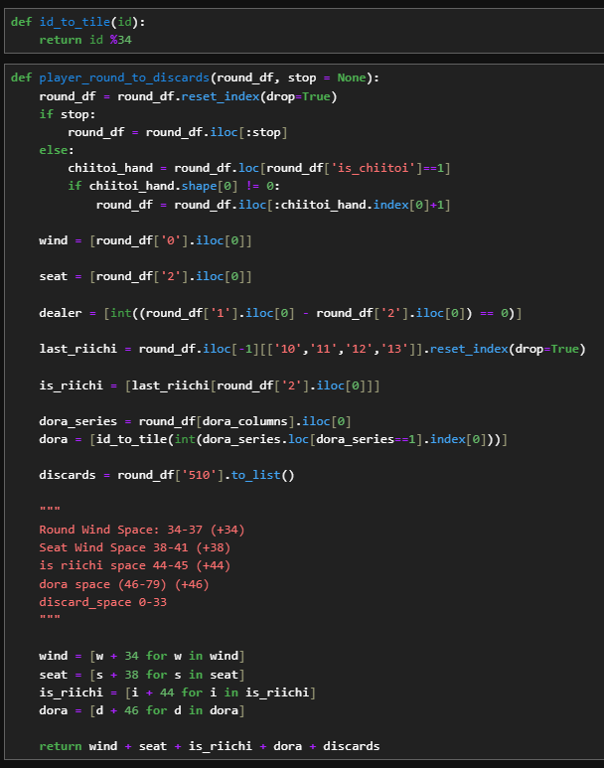
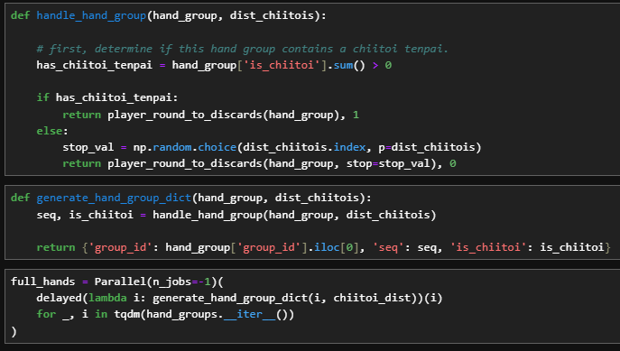
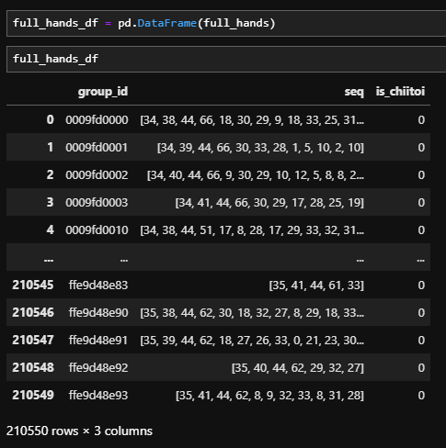
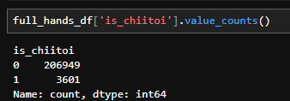

Slide 15
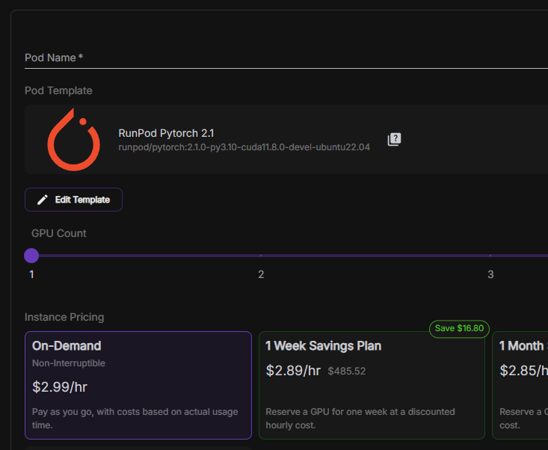
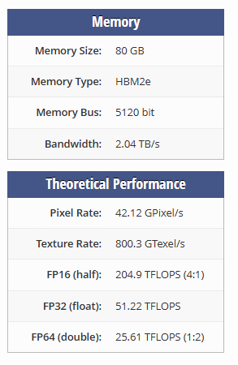

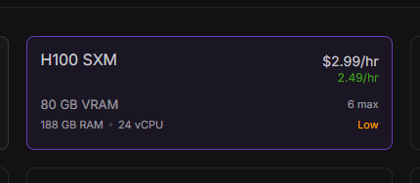

Slide 16

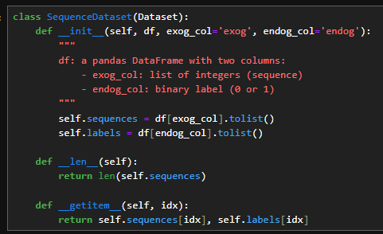
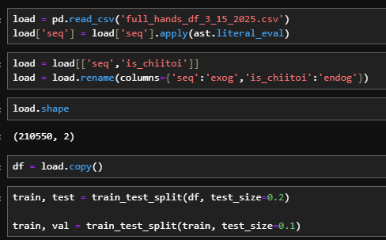


Slide 17
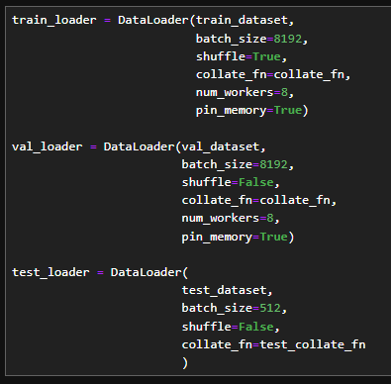
Larger batch sizes means faster training, but more GPU memory use.
Increase if the GPU can process data faster than the CPU can load it.
Good for GPU training
Bespoke function to set all sequences to be the same size via padding token (the integer ‘80’ in this case).
Don’t shuffle here to increase reproducibility.

Slide 18

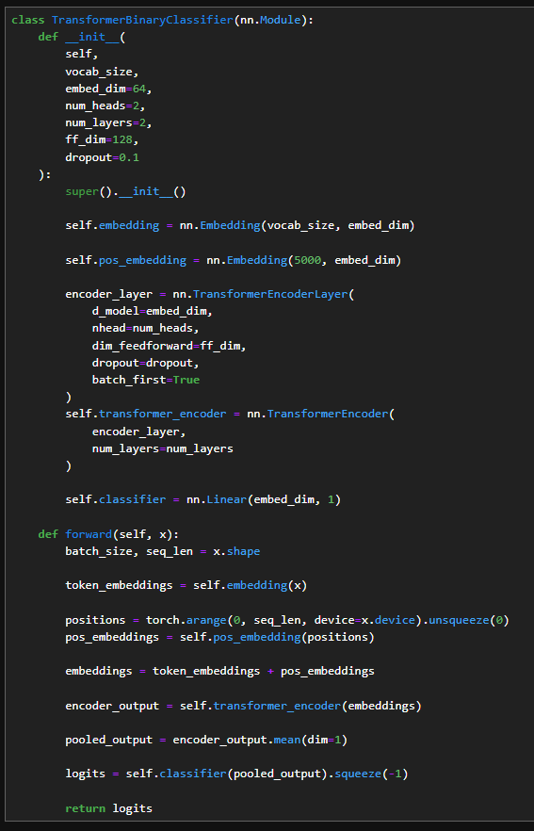
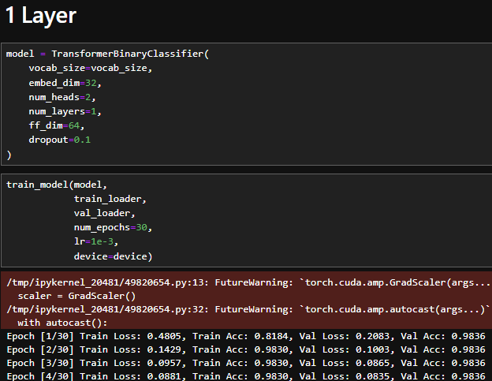
Token embedding
Position embedding
Define layers
Final layer
Pass embeddings through the encoder
Collapse output to scalar

Slide 19
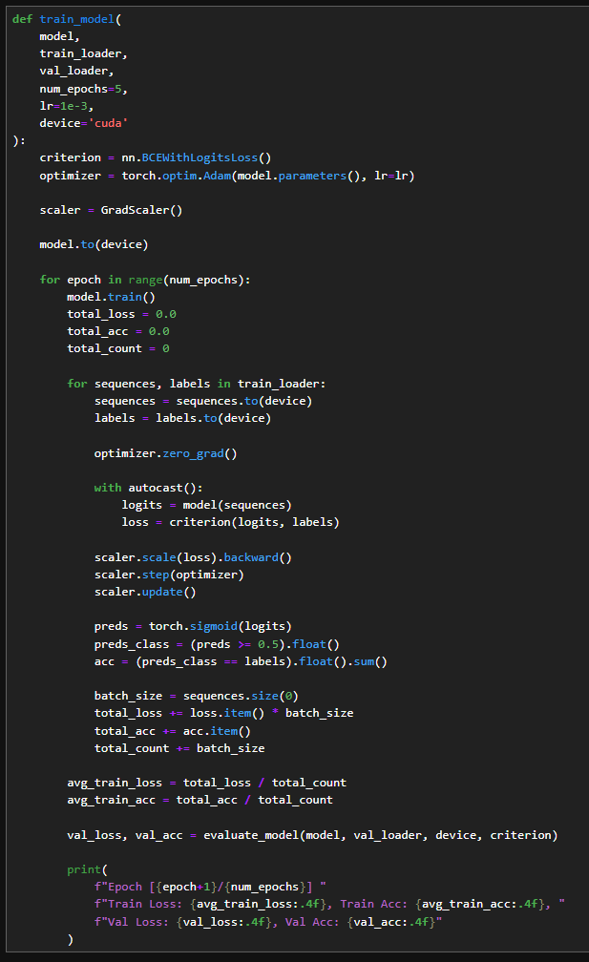
Binary classification loss function
Epoch loop
Batch loop
Clear previous gradients
Execute the model’s forward function
Update the weights via backpropagation of forward predictions.
Get validation metrics (useful for hyperparameter tuning)

Slide 20
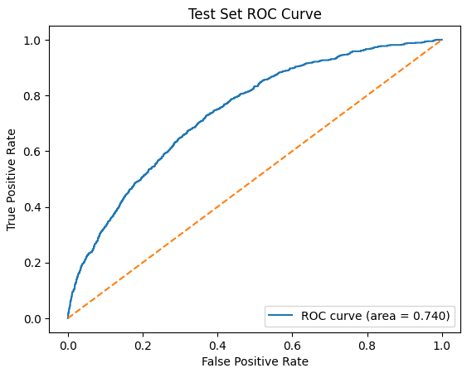
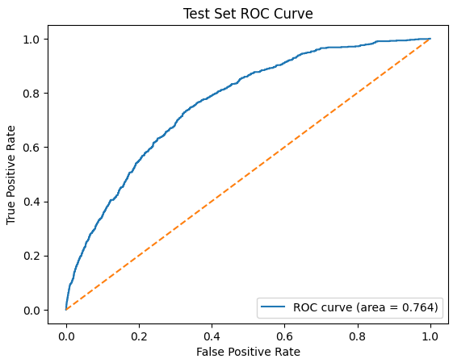
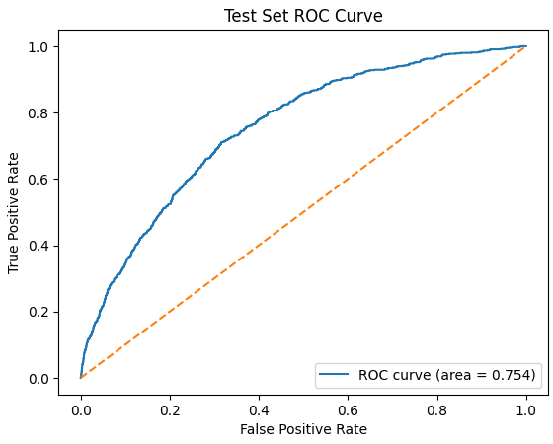
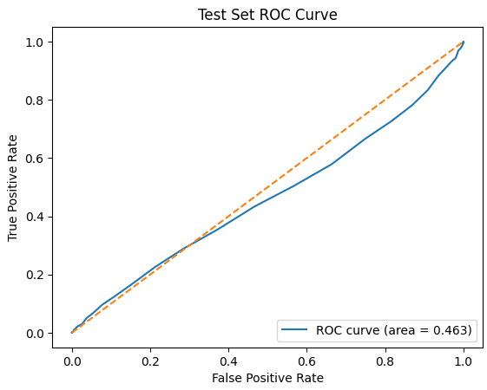
1 Layer
2 Layers
10 Layers
30 Layers

Slide 21
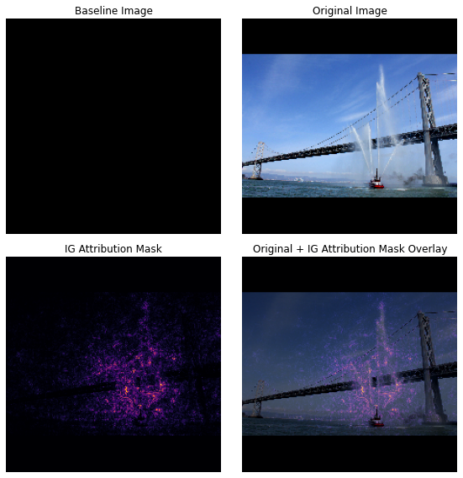
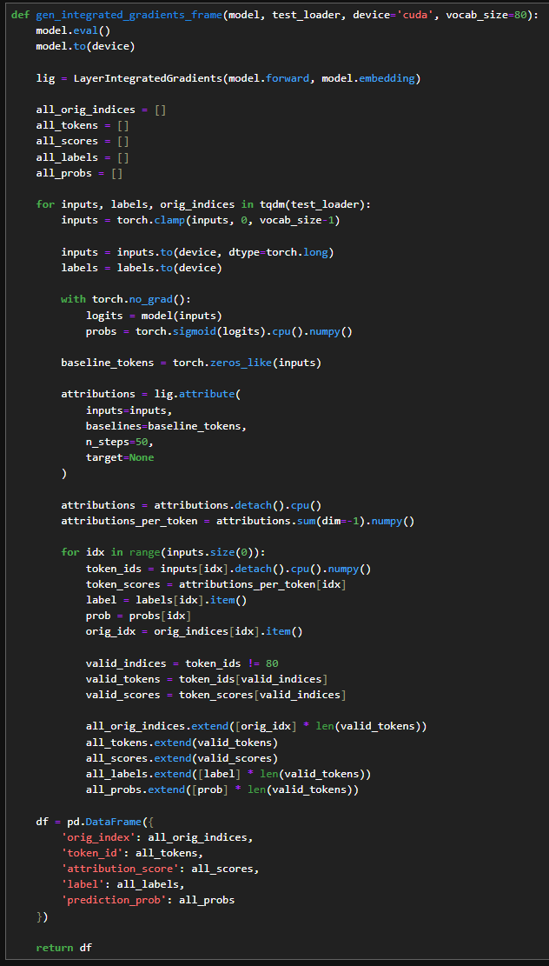
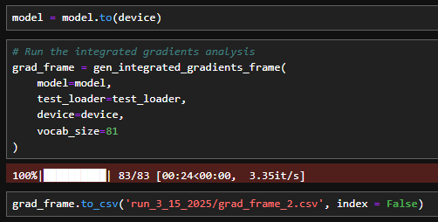
From the Captum library - assigns importance to inputs
Pixels positively associated with ‘is a fireboat’ during backpropagation.
For each input, record that input’s importance.
https://www.tensorflow.org/tutorials/interpretability/integrated_gradients
Can’t take our cargo ship to the grocery store.

Slide 22
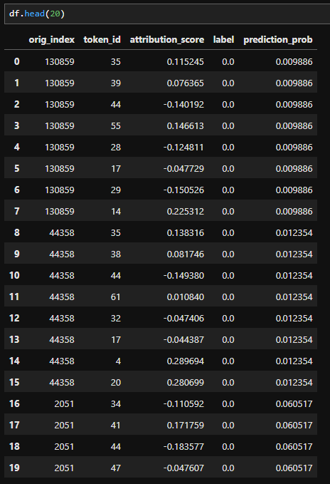
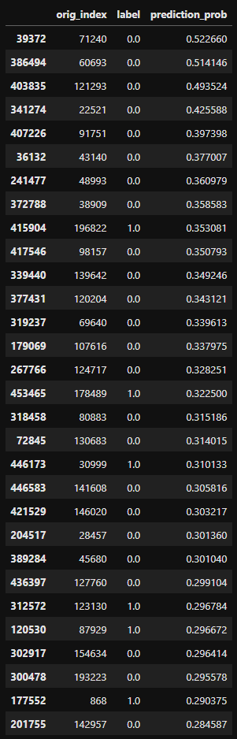
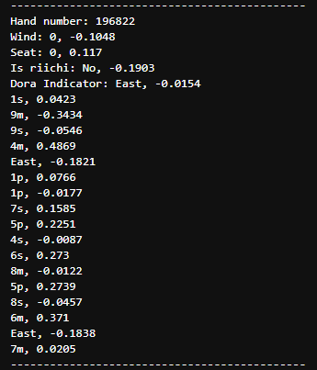

Slide 23
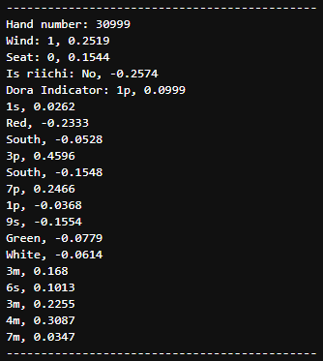
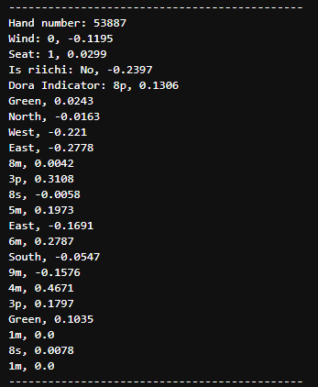
Halfway through the game
Early honors (negative influence)
Inner tiles before outer tile or honor
Dropping consecutive tiles

